Slide 1
Orthogonal Basis
Hung-yi Lee
Notes:
There are more exzmplea and another proof, that we can use

Slide 2
Outline
Orthogonal/Orthonormal Basis
Orthogonal Decomposition Theory
How to find Orthonormal Basis
Reference: Textbook Chapter 7.2, 7.3

Slide 3
Orthogonal Set
A set of vectors is called an orthogonal set if every pair of distinct vectors in the set is orthogonal.
An orthogonal set?
By definition, a set with only one vector is an orthogonal set.
Is orthogonal set independent?

Slide 4




Independent?
Any orthogonal set of nonzero vectors is linearly independent.
Let S = {v₁, v₂, …, v_{k}} be an orthogonal set v_{i} ≠ 0 for i = 1, 2, 😐, k.
Assume c₁, c₂, …, c_{k} make c₁v₁ + c₂v₂ + ☹ + c_{k}v_{k} = 0
c_{i} = 0
$$≠0$$
$$c_{1}=c_{2}=⋯=c_{k}=0$$

Slide 5





Orthonormal Set
A set of vectors is called an orthonormal set if it is an orthogonal set, and the norm of all the vectors is 1
Is orthonormal set independent?
Yes
$$\frac{1}{\sqrt{14}}\left[\begin{aligned}1 \\ 2 \\ 3\end{aligned}\right]$$
$$\frac{1}{\sqrt{3}}\left[\begin{aligned}1 \\ 1 \\ −1\end{aligned}\right]$$
$$\frac{1}{\sqrt{42}}\left[\begin{aligned}5 \\ −4 \\ 1\end{aligned}\right]$$
A vector that has norm equal to 1 is called a unit vector.

Slide 6

Orthogonal Basis
A basis that is an orthogonal (orthonormal) set is called an orthogonal (orthonormal) basis
$$\left[\begin{matrix}1 & 0 & 0 \\ 0 & 1 & 0 \\ 0 & 0 & 1\end{matrix}\right]$$
Orthogonal basis of R³
Orthonormal basis of R³

Slide 7
Outline
Orthogonal/Orthonormal Basis
Orthogonal Decomposition Theory
How to find Orthonormal Basis

Slide 8

Orthogonal Basis
Let $S=\left\{v_{1},v_{2},⋯,v_{k}\right\}$ be an orthogonal basis for a subspace W, and let u be a vector in W.
$$u=c_{1}v_{1}+c_{2}v_{2}+⋯+c_{k}v_{k}$$
$$\frac{u∙v_{1}}{{\left\|v_{1}\right\|}^{2}}$$
$$\frac{u∙v_{2}}{{\left\|v_{2}\right\|}^{2}}$$
$$\frac{u∙v_{k}}{{\left\|v_{k}\right\|}^{2}}$$
Proof
To find $c_{i}$
How about orthonormal basis?
$$u∙v_{i}=\left(c_{1}v_{1}+c_{2}v_{2}+⋯+c_{i}v_{i}+⋯+c_{k}v_{k}\right)∙v_{i}$$
$$=c_{1}v_{1}∙v_{i}+c_{2}v_{2}∙v_{i}+⋯+c_{i}v_{i}∙v_{i}+⋯+c_{k}v_{k}∙v_{i}$$
$$=c_{i}\left(v_{i}∙v_{i}\right)$$
$$=c_{i}{\left\|v_{i}\right\|}^{2}$$
$$c_{i}=\frac{u∙v_{i}}{{\left\|v_{i}\right\|}^{2}}$$

Slide 9
Example
Example: S = {v₁, v₂, v₃} is an orthogonal basis for R³

Slide 10



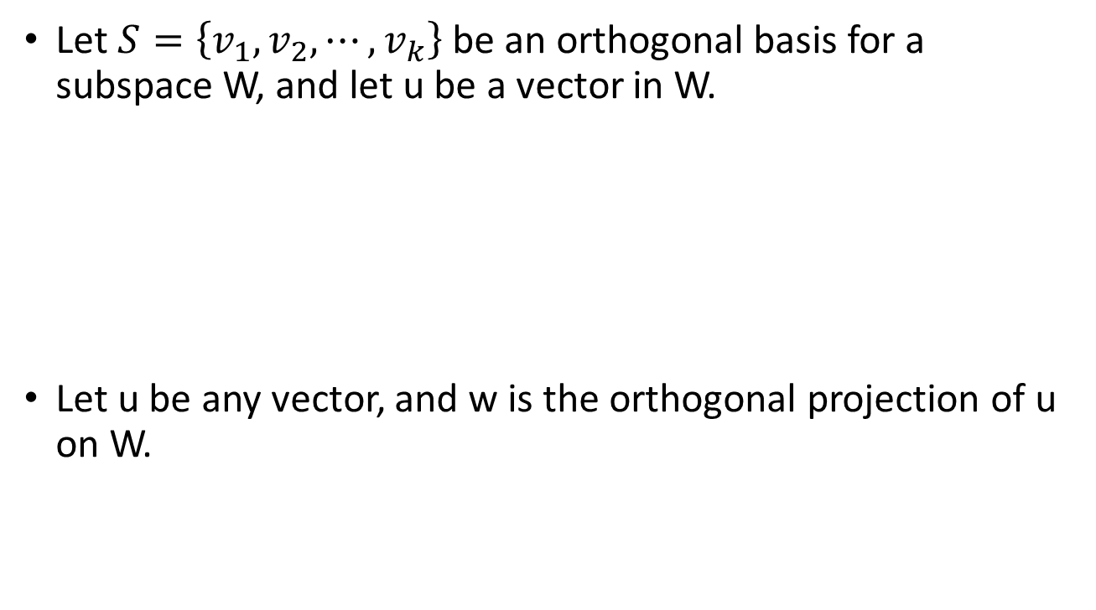





Orthogonal Projection
Let $S=\left\{v_{1},v_{2},⋯,v_{k}\right\}$ be an orthogonal basis for a subspace W, and let u be a vector in W.
Let u be any vector, and w is the orthogonal projection of u on W.
$$u=c_{1}v_{1}+c_{2}v_{2}+⋯+c_{k}v_{k}$$
$$\frac{u∙v_{1}}{{\left\|v_{1}\right\|}^{2}}$$
$$\frac{u∙v_{2}}{{\left\|v_{2}\right\|}^{2}}$$
$$\frac{u∙v_{k}}{{\left\|v_{k}\right\|}^{2}}$$
$$w=c_{1}v_{1}+c_{2}v_{2}+⋯+c_{k}v_{k}$$
$$\frac{u∙v_{1}}{{\left\|v_{1}\right\|}^{2}}$$
$$\frac{u∙v_{2}}{{\left\|v_{2}\right\|}^{2}}$$
$$\frac{u∙v_{k}}{{\left\|v_{k}\right\|}^{2}}$$

Slide 11










Orthogonal Projection
Let $S=\left\{v_{1},v_{2},⋯,v_{k}\right\}$ be an orthogonal basis for a subspace W. Let u be any vector, and w is the orthogonal projection of u on W.
$$w=c_{1}v_{1}+c_{2}v_{2}+⋯+c_{k}v_{k}$$
$$\frac{u∙v_{1}}{{\left\|v_{1}\right\|}^{2}}$$
$$\frac{u∙v_{2}}{{\left\|v_{2}\right\|}^{2}}$$
$$\frac{u∙v_{k}}{{\left\|v_{k}\right\|}^{2}}$$
$$P_{W}=C{\left(C^{T}C\right)}^{−1}C^{T}$$
$$C^{T}=\left[\begin{aligned}v_{1}^{T} \\ v_{2}^{T} \\ ⋮ \\ v_{k}^{T}\end{aligned}\right]$$
$$P_{W}=CD^{−1}C^{T}$$
$$C=\left[\begin{matrix}v_{1} & ⋯ & v_{k}\end{matrix}\right]$$
Projected:
$$w=CD^{−1}C^{T}u$$

Slide 12
Outline
Orthogonal/Orthonormal Basis
Orthogonal Decomposition Theory
How to find Orthonormal Basis

Slide 13
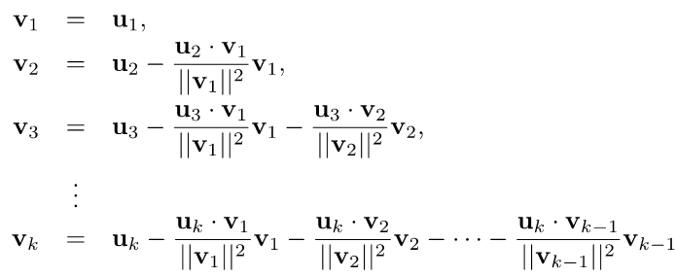
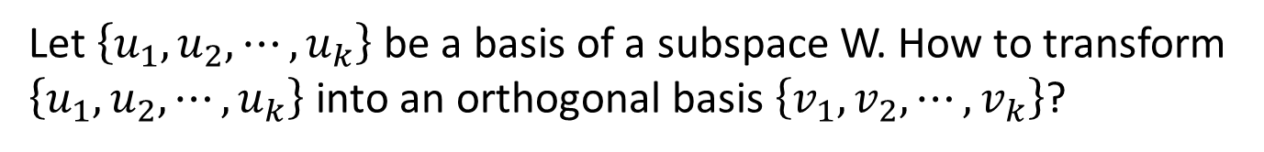
Orthogonal Basis
Let $\left\{u_{1},u_{2},⋯,u_{k}\right\}$ be a basis of a subspace W. How to transform $\left\{u_{1},u_{2},⋯,u_{k}\right\}$ into an orthogonal basis $\left\{v_{1},v_{2},⋯,v_{k}\right\}$?
Gram-Schmidt
Process
Then $\left\{v_{1},v_{2},⋯,v_{k}\right\}$ is an orthogonal basis for W
orthogonal

Slide 14
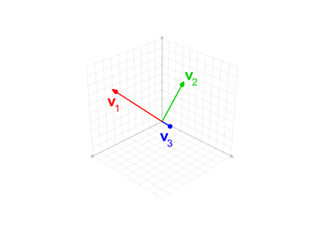
Visualization
https://www.youtube.com/watch?v=Ys28-Yq21B8

Slide 15
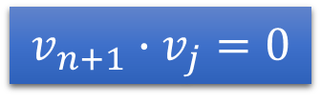
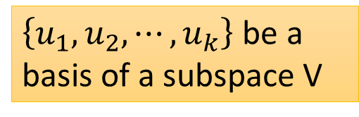
$\left\{u_{1},u_{2},⋯,u_{k}\right\}$ be a basis of a subspace V
none zero
orthogonal
The theorem holds for i = 1.
obviously
Assume the theorem holds for i=n, and consider the case for n+1.
$$v_{n+1}∙v_{j}=0$$
(j < n + 1)

Slide 16

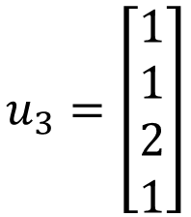
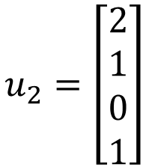
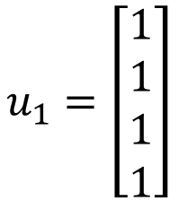
Example
S = {u₁, u₂, u₃}
Is a basis for subspace W
$$u_{1}=\left[\begin{aligned}1 \\ 1 \\ 1 \\ 1\end{aligned}\right]$$
$$u_{2}=\left[\begin{aligned}2 \\ 1 \\ 0 \\ 1\end{aligned}\right]$$
$$u_{3}=\left[\begin{aligned}1 \\ 1 \\ 2 \\ 1\end{aligned}\right]$$
(L.I. vectors)
Then S ′ = {v₁, v₂, v₃} is an orthogonal basis for W .
S ′′ = {v₁, v₂, 4v₃} is also an orthogonal basis.

